Slide 1

The Titanic
Richard Ahn

Slide 2
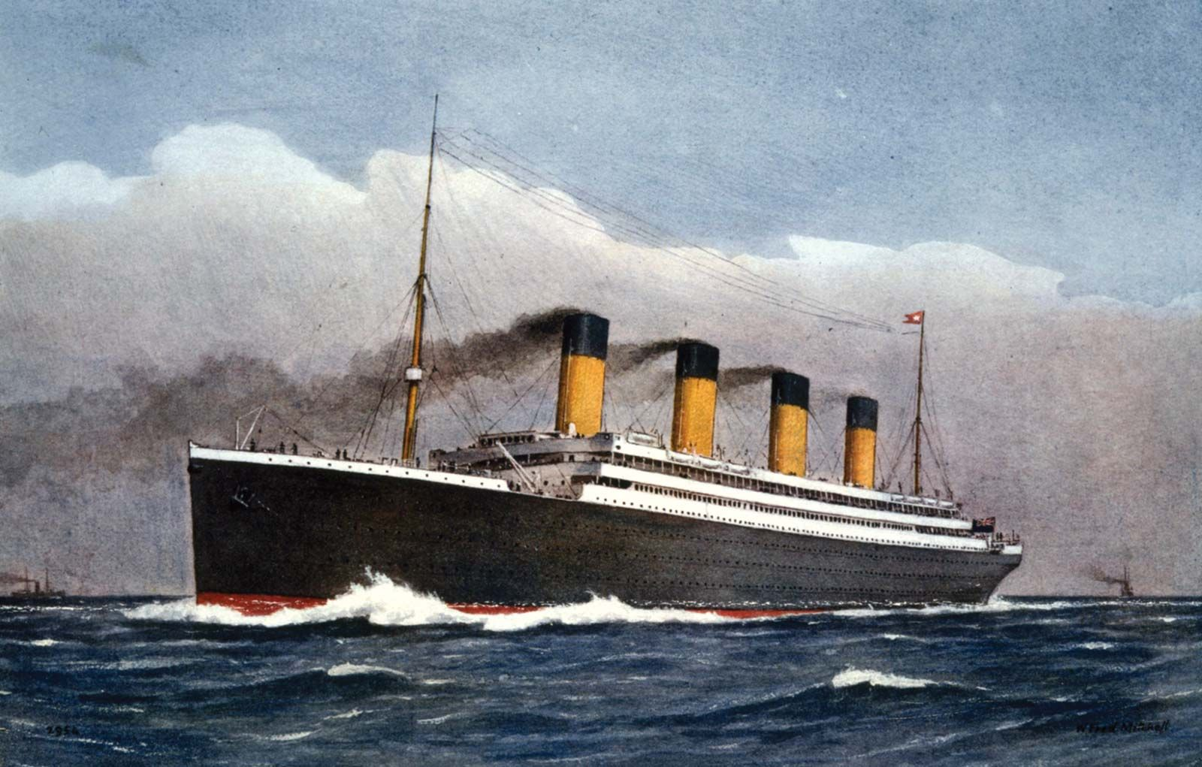
Introduction
Historical ship that met its tragedy
Sank in 1912 after striking an iceberg
Amazing class, scale, beauty, and magnificence
Thought to be unsinkable, yet many people die

Slide 3
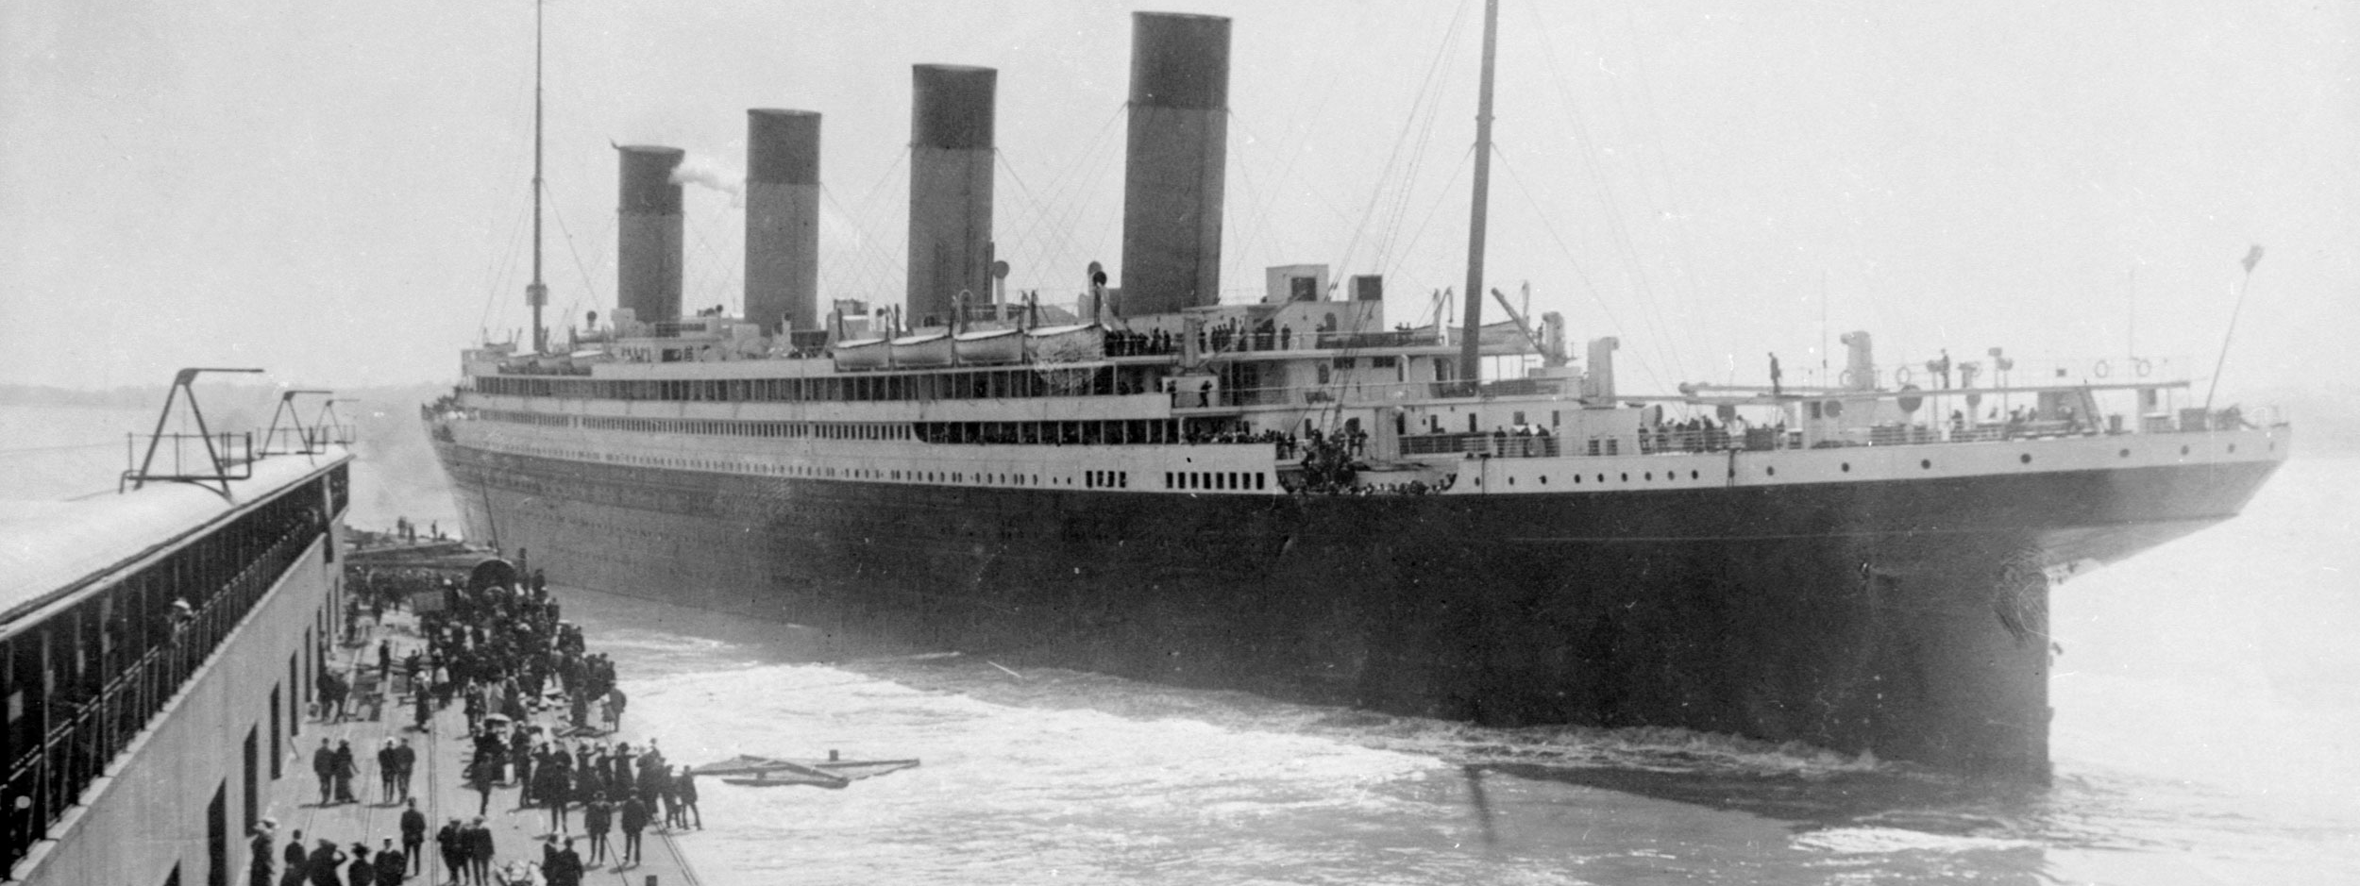
What sorts of people were more likely to survive?

Slide 4
Hypothesis
Women are more likely to survive as well as children with siblings
People of higher class
Convenient location
Provided assistance
Younger people

Slide 5
Our Datasets
3 datasets
Training
Where most data manipulation and analysis occurs
Feature creations and analysis
Test
Tests accuracy of classifier with models
Sample submission
Requires same shape and column formatting

Slide 6
The data columns
Survival
Passenger Class
Sex
Age
Siblings and Spouses
Parents and Children
Ticket
Fare
Cabin
Embarking point

Slide 7
My Project Process
Explore the individual columns to learn more about them
Created plots and bar graphs to comprehend the distribution better
After looking at features, create ML models to find which algorithms provide best results and create a function to generalize the structure of the algorithms
Check for which model has best accuracy (cross-validation since data is limited sample)
Check which features were most important

Slide 8
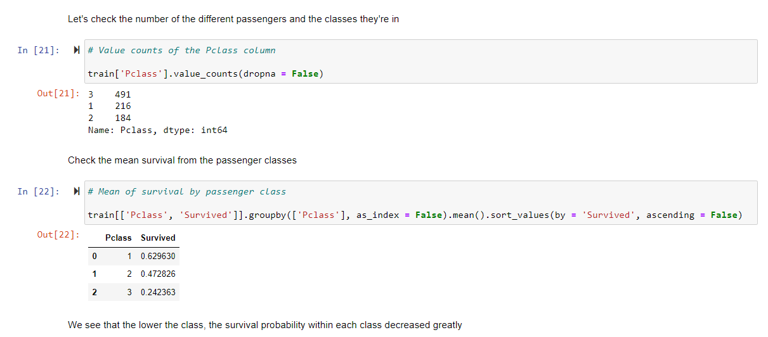
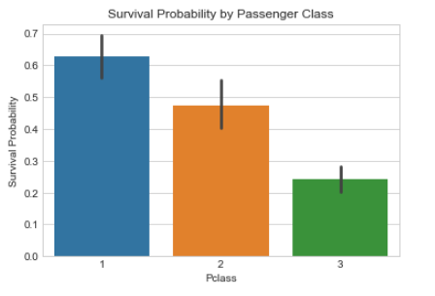
Passenger Class

Slide 9
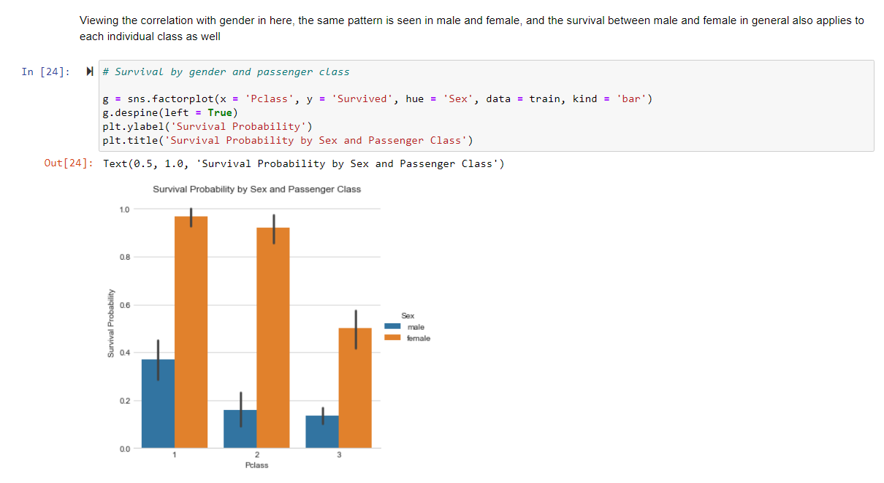
P Class (Cont)

Slide 10
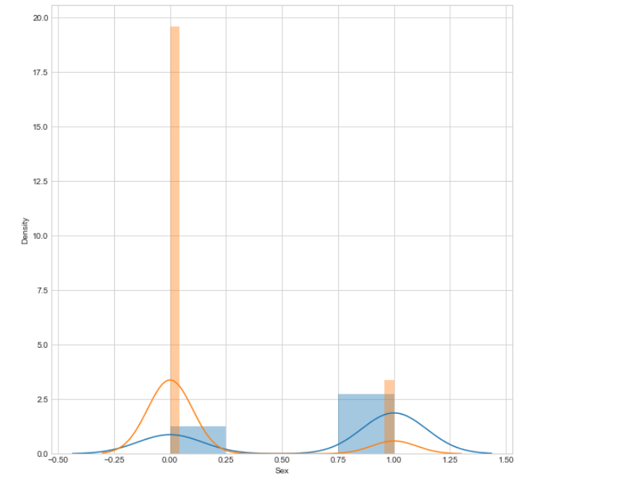
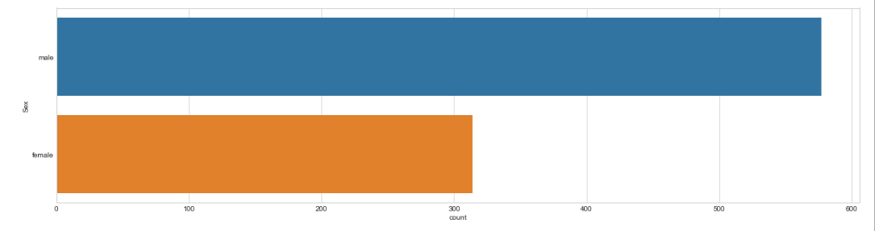
Male-Female

Slide 11
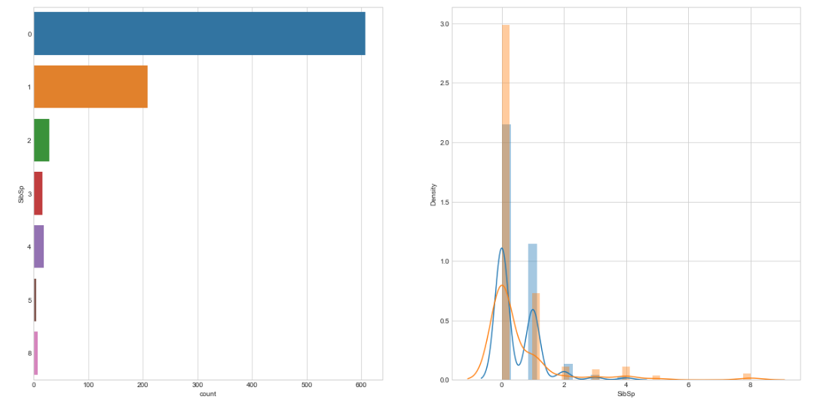
Sibling/Spouse

Slide 12
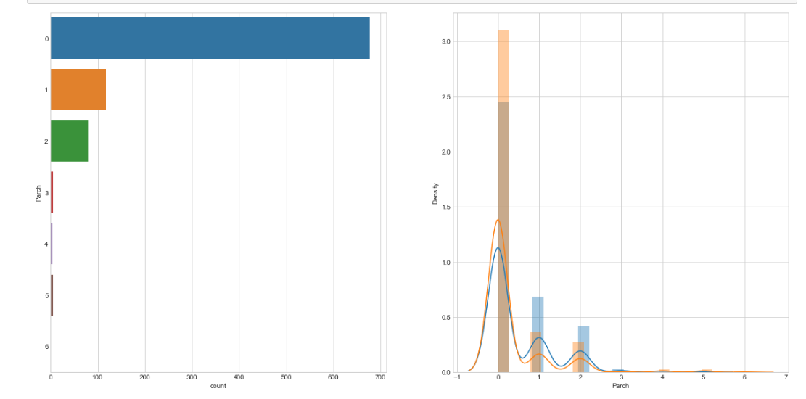
Parent-Children

Slide 13
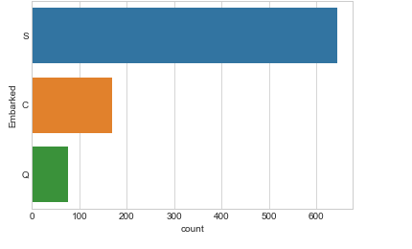
Embarked
Point of embarkation where
C = Cherbourg
Q = Queenstown
S = Southampton

Slide 14
Other Features
There were several other numerical features, but there were too much of a skew or too many missing values to accurately evaluate them
If only a few values were missing, an efficient method to have an accurate analysis is to remove the rows with the missing column values

Slide 15
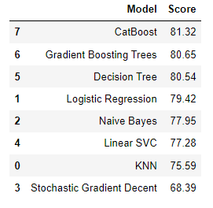
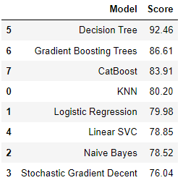
Machine Learning
Below are following models and accuracies
Logistic Regression: 79.98
K—Nearest Neighbors: 80.2
Gaussian Naïve Bayes: 78.5
Linear Support Vector Machines: 78.85
Stochastic Gradient Descent: 76.04
Decision Tree Classifier: 92.46
Gradient Boost Trees: 86.61
CatBoost: 83.91

Slide 16
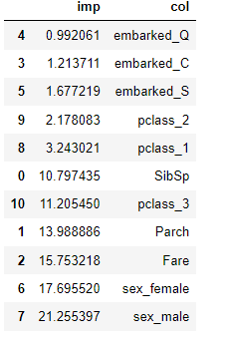
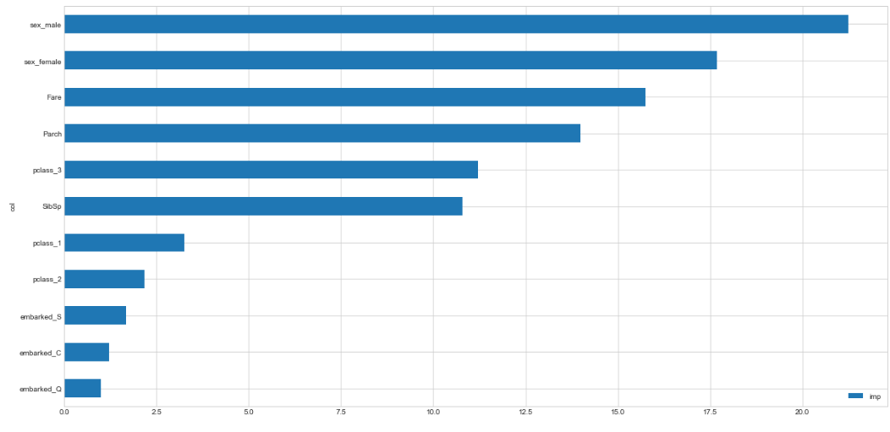
Feature Importance

Slide 17
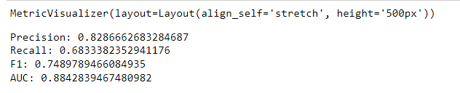
Precision and Recall
Recall is low, thus a higher amount of false negatives
Precision is higher therefore there's less false positives

Slide 18
Conclusion
Gender was one of the most important, and ultimately more women survived than died in comparison to men by a large gap
The Fare and being a parent or child really mattered as well, and this may be due to being provided guidance from crew members in the case of fare, and children and women being prioritized in the lifeboats
Passenger class combined has also had a large importance value likely because those who are of lowly class may have had a lot more difficulty leaving the ship
Overall, those who were women and were by themselves were more likely to survive in comparison to those who were traveling with family members and were male and old

